Slide 1
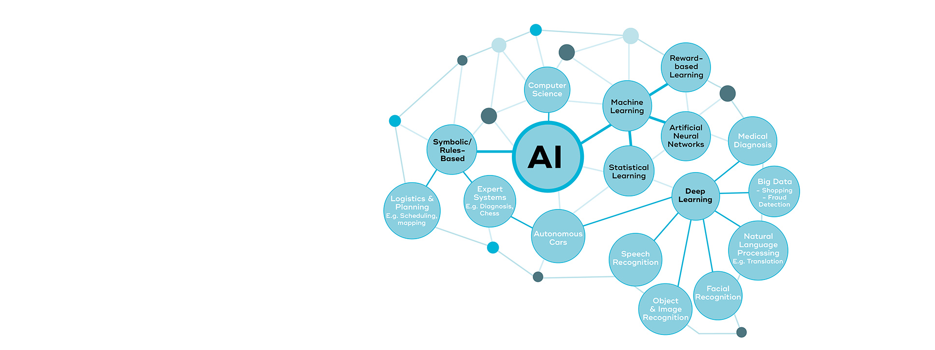
What is AI?

Slide 2
Introduction
What is AI?
AI Vs Machine Learning Vs deep Learning
Where is AI used?

Slide 3
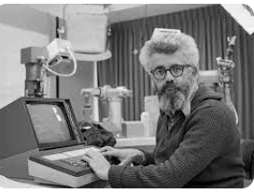
About AI
In 1950,John McCarthy named artificial intelligence.
In 1980 & 1990s,algorithms and machine learning began to automate tasks with data.
After that neuro network it has reached a stage where it can learn itself from the so-called data and then act.

Slide 4
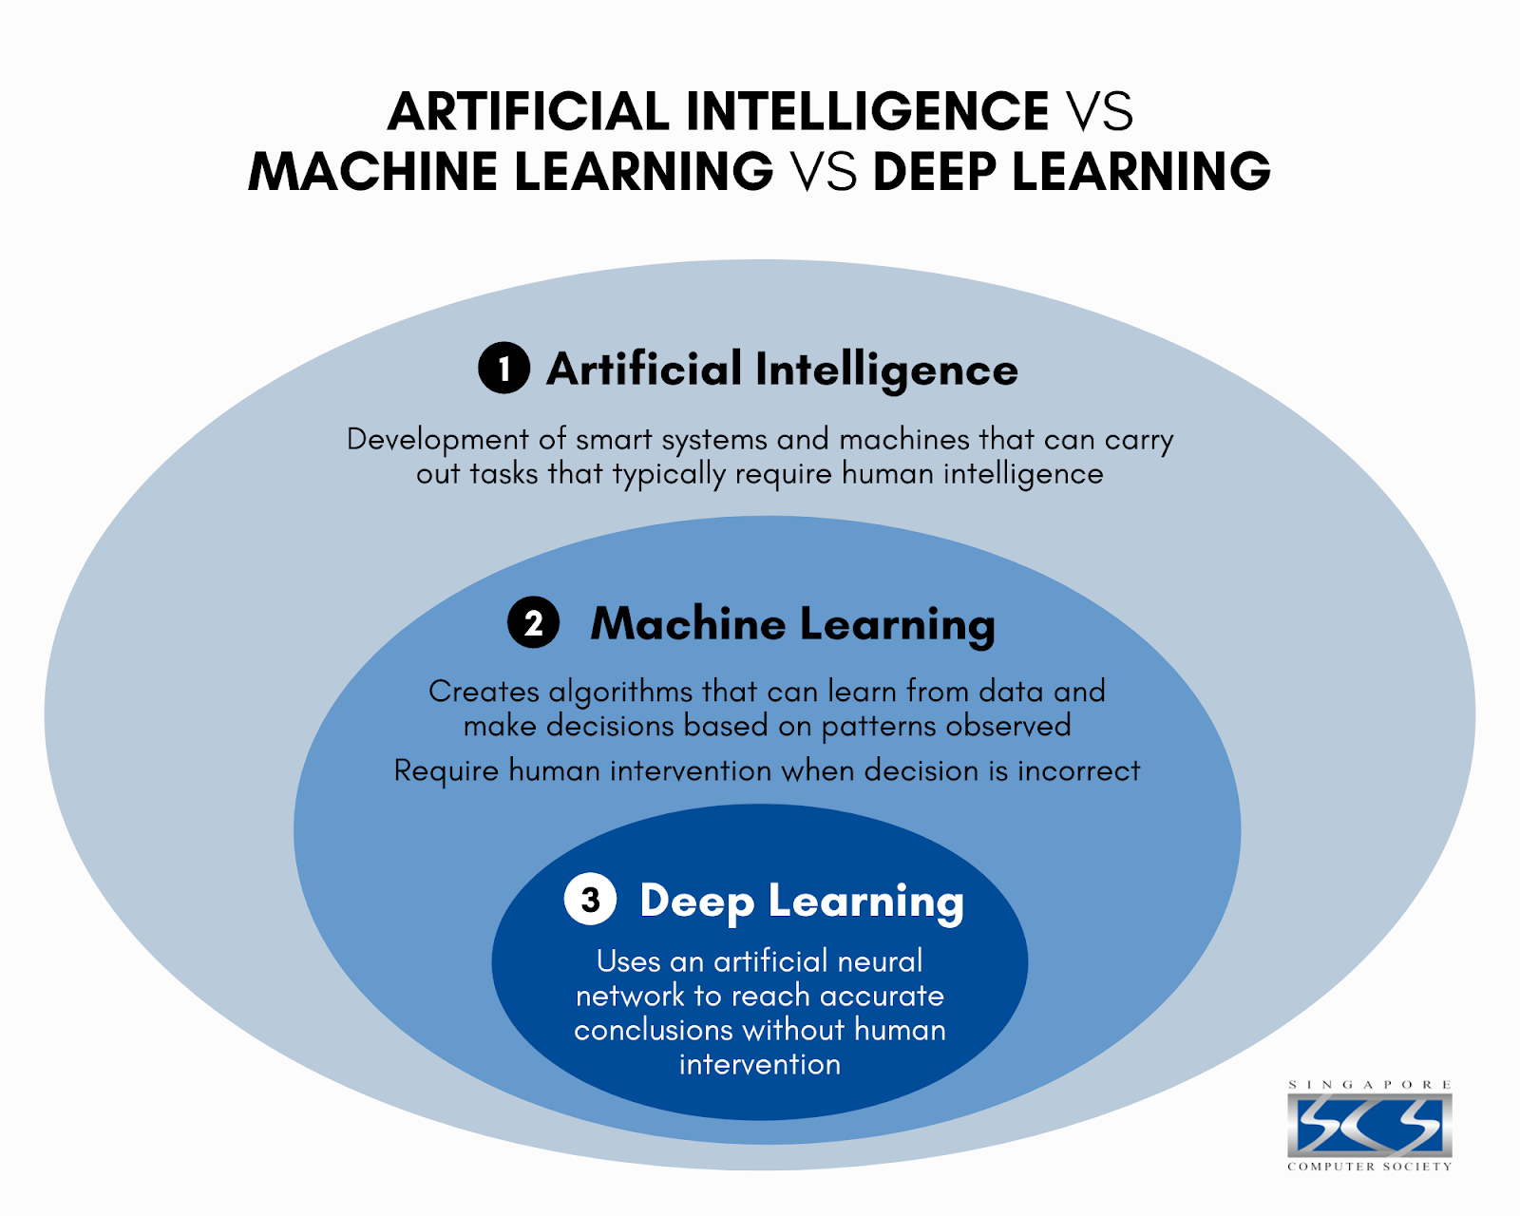

Slide 5
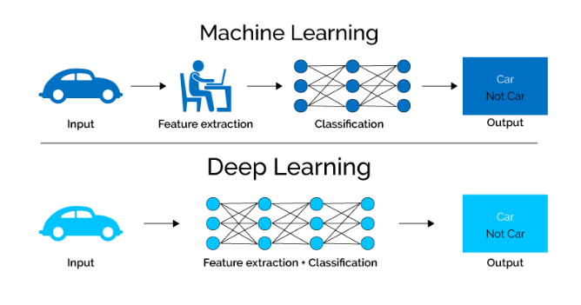
Compare Machine and Deep Learning

Slide 6
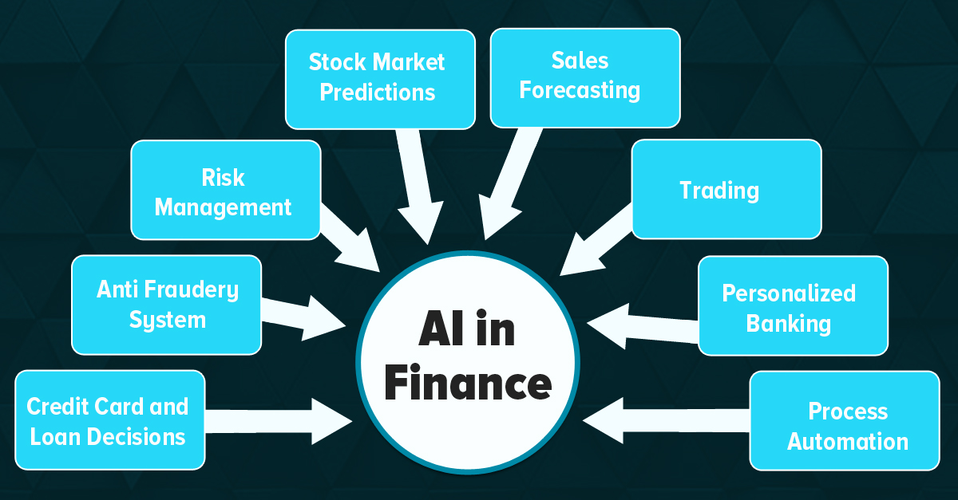
Benefits of AI in Finance

Slide 7
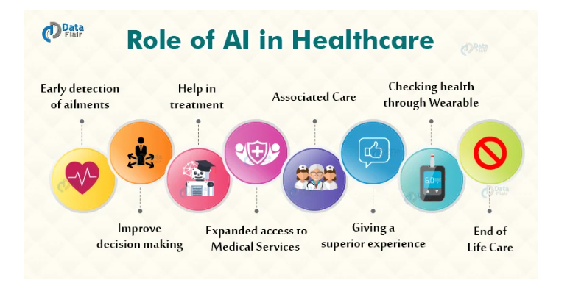
Benefits of AI in Healthcare

Slide 8
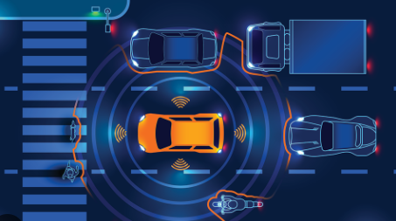
Benefits of AI in Transport -traffic management -Learn from data camera and sensors , drive safety and traffic accidents

Slide 9
THANK YOU!

